Slide 1
Readiness Checklist for Your Strategic Fundraising and Capital Campaigns
Charles Okigbo
NPEI-NDSU
Patrick Kirby
DGB Fundraising
Notes:
This presentation will cover the different stages of a fundraising campaign for nonprofits.

Slide 2

The Nonprofit Sector Today
The 2024 landscape
Making an impact and facing unique fundraising challenges
What better way to raise money, than a Capital Campaign!?
Notes:
Nonprofits are the 'third sector' right after governments and businesses. In this presentation, we will dive into the vibrant world of nonprofits, the unique fundraising challenges this sector faces, and what the landscape may look like in 2024.

Slide 3

Strategic Fundraising & Capital Campaigns (SFCC)
Why do nonprofits struggle? Often, it's due to financial kryptonite
SFCC to the rescue! Learn why strategic fundraising isn't just nice to have
Strategic fundraising is a necessity to avoid being a one-hit-wonder
Notes:
Nonprofits often struggle due to financial challenges. This is where strategic fundraising and capital campaigns can be a game-changer. Learn why strategic fundraising is a necessity to avoid being a one-hit-wonder and how SFCC can help.

Slide 4

Why Embrace SFCC?
Facing a growing need but shrinking resources? You're not alone in this competitive arena
With strategic solicitations, even the underdog can score big
Fundraising is both art and science, and nearly anyone can master it with the right tools
Notes:
If you are facing a growing need but have limited resources, don't worry! Even the underdog can score big with strategic fundraising. Fundraising may seem like an art, but it is also a science, and almost anyone can master it with the right tools.

Slide 5

How to Launch and Lead SFCC Like a Pro
Explore three models to fit your nonprofit's style
From building your dream team to throwing the victory party
Key phases include the silent phase and the public phase
Notes:
Launching and leading a successful SFCC campaign can be challenging, but don't worry, we've got you covered. We'll explore three different models to fit your nonprofit's style and walk through the essential steps from building your dream team to throwing the victory party.

Slide 6

Readiness: Are You Ready to Rock SFCC?
Unpack common fears: Inexperience? Fear of rejection? No problem, we've got your back
Learn from leaders who've been in your shoes and conquered
Notes:
Are you ready to rock SFCC, but feeling anxious or unprepared? We've got your back. We will unpack common fears and provide insights from leaders who have been in your shoes and conquered.

Slide 7

Curricular Readiness: The Five Domains
Language & Literacy
Cognition & General Knowledge
Approaches to Learning
Physical Well-being & Motor Development
Social & Emotional Development
Notes:
Curricular readiness is all about preparing young children for learning. It involves understanding the five domains that shape your child's development: language and literacy, cognition and general knowledge, approaches to learning, physical well-being and motor development, and social and emotional development. In this presentation, we will explore each of these domains in detail and offer practical tips for parents and caregivers on how to support their child's readiness for school.

Slide 8

Our Checklist for Readiness
Strategic Planning
Compelling Stories
Target Audience
Media Channels
Notes:
Our standard checklist covers 23 items that every nonprofit should consider when launching a fundraising campaign. In this slide, we will focus on four key areas: strategic planning, compelling stories, target audience, and media channels, and explain why they are important for campaign success.

Slide 9
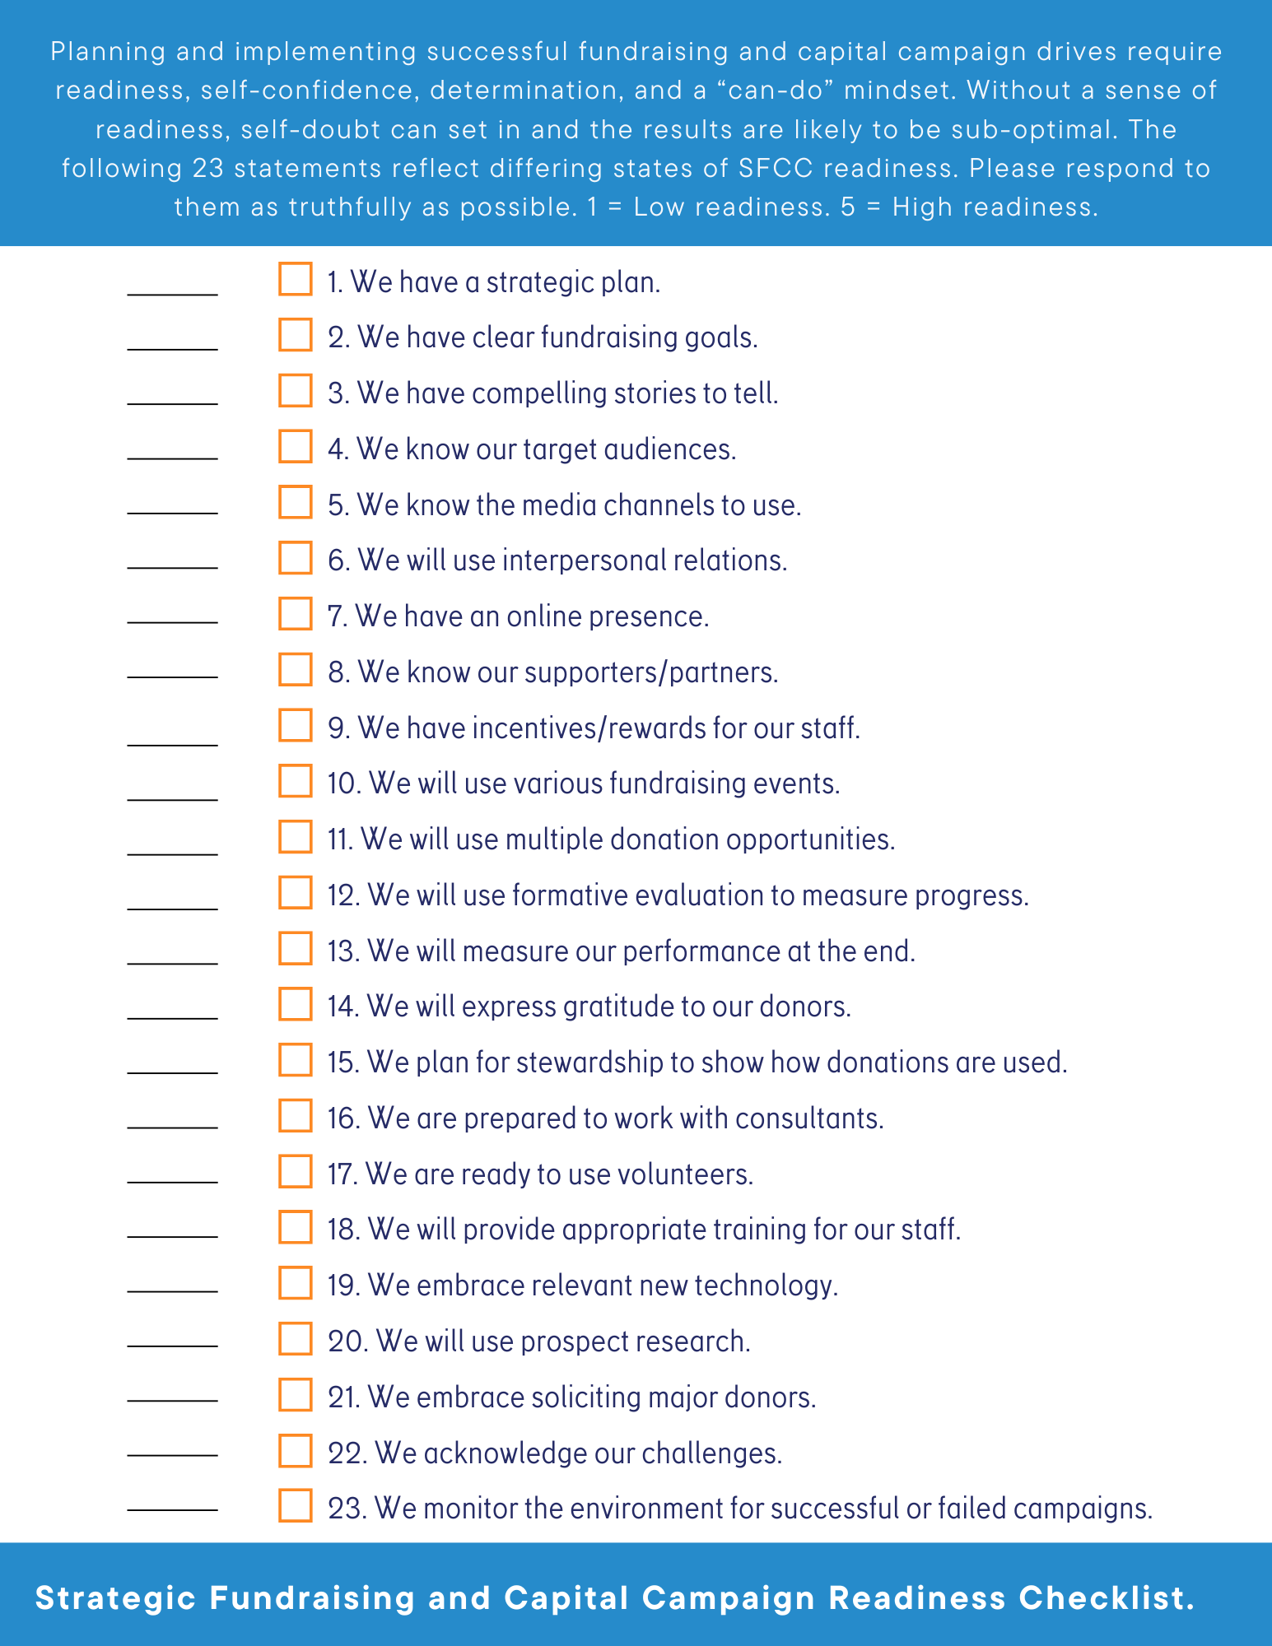

Slide 10
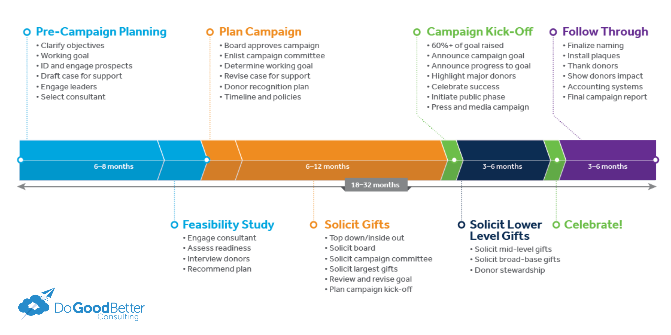

Slide 11

Pre-Campaign Planning
Clarify objectives
Set a working goal
Identify and engage prospects
Draft the case for support
Engage leaders
Select a consultant
Notes:
Pre-Campaign Planning is important because it establishes clear objectives and goals, ensuring the organization is well-prepared and has a solid foundation for the campaign.

Slide 12

Feasibility Study
Engage a consultant
Assess organizational readiness
Interview potential donors
Recommend a plan based on findings
Notes:
The Feasibility Study provides critical insights and recommendations to shape the campaign strategy and improve chances of success.

Slide 13

Plan Campaign
Board approves the campaign
Enlist the campaign committee
Determine the working goal
Revise the case for support
Develop a donor recognition plan
Establish timeline and policies
Notes:
Planning the Campaign ensures all aspects of the campaign are well-planned and organized, gaining the necessary approvals and setting the stage for a successful launch.

Slide 14

Solicit Gifts
Engage top-down/inside-out solicitation
Solicit the board members
Solicit the campaign committee
Solicit the largest gifts
Review and revise the campaign goal
Plan the campaign kick-off
Notes:
Soliciting Gifts builds a strong foundation of major gifts, demonstrating significant early progress and commitment.

Slide 15

Campaign Kick-Off (3-6 Months)
Ensure 75%+ of the goal is raised
Announce the campaign goal
Highlight progress towards the goal
Recognize major donors
Celebrate initial success
Initiate the public phase with events and media campaigns
Notes:
The Campaign Kick-Off is the official launch of the campaign to the public, aiming to generate excitement and momentum. It is important to ensure that at least 75% of the goal is raised at the time of the launch. The campaign goal should be announced, progress towards the goal should be highlighted, and major donors should be recognized. The kick-off marks the beginning of the public phase and should be initiated with events and media campaigns.

Slide 16

Solicit Lower-Level Gifts (Part of Public Phase)
Solicit mid-level gifts
Solicit broad-base gifts
Implement donor stewardship strategies
Notes:
The Solicit Lower-Level Gifts phase of the public phase is when fundraising efforts are expanded to include mid-level and broad-base donors. During this phase, mid-level gifts should be solicited, broad-base gifts should be solicited, and donor stewardship strategies should be implemented. This phase helps to engage a wider donor base and ensure broad community support.

Slide 17

Time to Celebrate!
Host celebration events
Recognize donors and volunteers
Share success stories and campaign impact
Notes:
Celebrate! marks the successful conclusion of the campaign and celebrates the achievements. During this phase, celebration events should be hosted, donors and volunteers should be recognized, and success stories and campaign impact should be shared. This phase reinforces donor relationships, celebrates community support, and lays the groundwork for future fundraising efforts.

Slide 18

Follow Through (3-6 Months)
Finalize naming opportunities
Install plaques
Thank donors
Show donors the impact of their contributions
Implement accounting systems
Compile the final campaign report
Notes:
The Follow Through phase focuses on completing the campaign, recognizing contributions, and ensuring all commitments are met. This phase involves finalizing naming opportunities, installing plaques, thanking donors, showing donors the impact of their contributions, implementing accounting systems, and compiling the final campaign report. This phase is important because it ensures all promises are fulfilled, donors are appropriately recognized, and the campaign’s impact is documented.

Slide 19

Summary and Conclusions: You're Closer to Success Than You Think
Recap: SFCC isn’t just necessary but transformative.
We’re not just telling you that you can succeed—we’re showing you how.
Notes:
In this presentation, we've shown you why strategic fundraising and capital campaigns are essential for nonprofits that want to thrive in a competitive environment. We've also provided practical advice on how to launch and lead SFCC like a pro, taken you through our self-assessment tool, and shared our recommendations for taking the stage. We hope that you feel inspired and empowered to take your fundraising efforts to the next level!

Slide 20

Our Recommendations for Taking the Stage
Try our self-assessment—it's like a soundcheck for your fundraising concert.
Empower your organization to embrace the challenge. Remember, every big act started small.
Notes:
In this slide, we offer two recommendations for taking the stage and achieving success with your fundraising campaign. First, try our self-assessment tool, which is designed to help you identify areas of strength and weakness in your campaign planning. Second, empower your organization to embrace the challenge of fundraising by remembering that every big act started small. With the right mindset and tools, you can achieve great things!

