Slide 1

How Endowment Works &
Giving Techniques & Options
Kevin J. Dvorak, CFP® President & CEO
May 30, 2024

Slide 2
Nothing that the presenter says today should be taken as legal or tax advice, if you want that, hire a real professional.

Slide 3
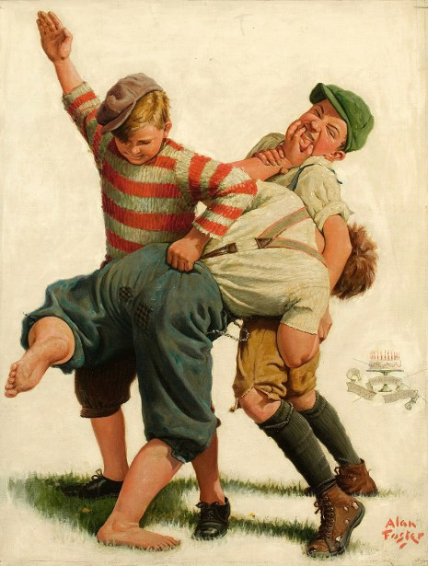

Slide 4


Slide 5
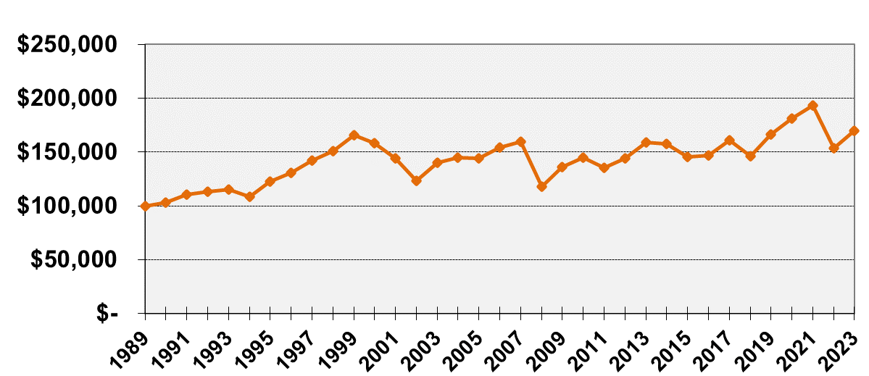
The Power of Endowment
The Power of Endowment: Retained Market Value of $100,000
Invested on 12/31/1989 (based on 5% total spending – 4% grant + 1% admin fee)
* Fund Value in 2023: $169,590
* Total $ given in grants: $192,822

Slide 6
Endowment Examples
Fund | Year Started | Current Assets* | Approximate Annual Grants
Harvey Public Library | 2017 | $140,502 | $5,600
First Care Health Center | 1998 | $319,211 | $12,000
Jeremiah Program Fargo Moorhead Scheel Barry Endowment | 2018 | $641,512 | $25,000
Carrington Community Endowment Fund (includes McGinn-Kunkel estate) | 1980 | $701,081 | $28,000
Clarence Johnson & Eunice Iwen Community Foundation for Arthur, ND | 2005 | $6,635,255 | $265,000

Slide 7
Various Charitable Giving Techniques to Build Your Endowment Fund
(or your project fund, general operating, etc.)

Slide 8
Outright Gift of Cash
Simplest way to give
Cash, Check, or Credit Card

Slide 9
Charitable IRA Rollover
No taxes on the amount you transfer (if you are 70 ½ or older)
Satisfies your Required Minimum Distribution for the year (if you are 72 and must take distributions)
Check must be sent DIRECTLY from IRA Trustee to the charity
Rollover gifts not allowed to donor-advised funds or private foundations

Slide 10

Gifts of Appreciated Assets
Asset must be transferred to charity
Deduction is full market value on date of transfer
Publicly-traded securities is the mean price on date of transfer (average of high and low).
Real Estate

Slide 11
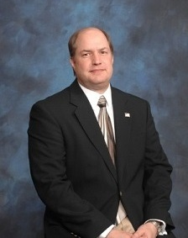
Bequests (a gift in your will)
Specific dollar amount
Certain percentage of the estate
Remainder of the estate after gifts to family, friends, and other organizations

Slide 12

Named Beneficiary of Retirement Accounts

Slide 13

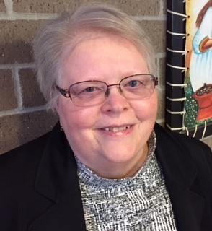
Gifts of Cash Value Life Insurance
Charity
* Just designating the charity as a beneficiary will NOT generate a tax deduction!

Slide 14
Charitable Gift Annuity
A contract that pays a guaranteed dollar amount annually to the donor and a second annuitant, if desired
Remainder goes to the charity
Sample Annual Gift Annuity Payout For a $10,000 gift.*
Age | Annual Annuity | Income Tax Deduction** | Income Taxed | Tax-Free Income | Maximum ND Income Tax Credit
60 | $520 | $3,384 | $247 | $273 | $1,354
65 | $570 | $3,494 | $245 | $325 | $1,398
70 | $630 | $3,725 | $238 | $392 | $1,290
75 | $700 | $4,126 | $230 | $470 | $1,650
80 | $810 | $4,519 | $233 | $577 | $1,808
*rates subject to change, for illustration only ** income tax deduction in year of gift only

Slide 15
The Fundamentals of a Successful Charitable Gift Annuity Program
(acga-web.org)
Notes:
Here is the link.

Slide 16
CRAT – Charitable Remainder Annuity Trust
Prepared for Farm Lady 10% Annuity Trust
Property
$300,000
Principal
$300,000
Gift to trust.
Deduct $33,321,
Saves $11,662.
NDCF
$200,000
(Approximate Value)
Term of
10 years
Fixed payout each year of $30,000.
Effective rate 10.4%.
Trust decreases for 10 years. Trust to charity.

Slide 17
Charitable Remainder Unitrust
Transfer cash or assets to fund the unitrust
Trust is invested and donor receives annual income from the unitrust for life or a certain term of years
Donor receives an immediate tax deduction for the charitable portion of the trust
Charity benefits from what remains in trust after all payments have been made

Slide 18

Gift of Home or Farm with Reserve Life Estate

Slide 19
ND Income Tax Credit
Some gifts may be eligible for the 40% ND income tax credit.
* Estimated tax deductions and credits for the 32% Tax Bracket. Consult your tax advisor.

Slide 20


Slide 21
Thank you!
Kevin J. Dvorak, CFP® President & CEO

