Slide 1
NDANO
Technology – Your Most Valuable Employee

Slide 2
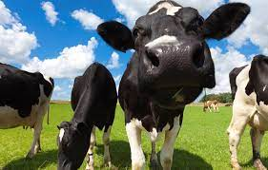
Trina Michels

Slide 3
Passion For Technology
Technology is a long race. The winners are not those who start fast, but those who keep running

Slide 4
2020-2024 CONDITIONS FACING NONPROFITS
1
Persistent Interest Rates – Market Pressures
Cost of Doing Business is Increasing
Automation vs Expansion vs Talent
Additional Demand from Nonprofits
2
Rising Cost Human capital
Retention / Employee Experience / Social Factors (i.e., Remote vs On Site)
3
Pace of Technology Advancement
Need for interconnected systems / Cybersecurity Risk / The “Distributed Enterprise”
4
Total Experience
Be Where Our Constituents Are / Every Platform / 24-7
Notes:
How Macro-economic Considerations Affect Long-term Build Project Decisions" which I think would be good to somehow mention as a tie in to your slides - something quick like "There's even an interview / blog post on Boomi.com where one of your SC"s Barry Gerdsen outlines very similar economic risks and why the Boomi platform i a good fit..."

Slide 5
Inside the Nonprofit
Current Sentiment
Pessimism is on the rise
Persistent economic uncertainty
No more "growth at all costs" strategy
Efficient Growth
Reduce cost
Enhance internal productivity
Profitable and sustainable
Focus on Constituent Experience
Nonprofits struggle to champion the value of existing solution providers and quantify mission outcomes
Use Your Data
More effective mission offerings
Improve targeting
Improve constituent outcomes
Maintain regulatory compliance reporting
Notes:
Different approach to investment
Pessimism is on the rise, leading to longer sales cycles and more abandoned sales cycles
Persistent economic uncertainty makes the "growth at all costs" strategy a harder pill to swallow
Efficient growth model is being required - reduce cost and enhance internal productivity. High interest rates make doing what we were doing when interest rates were low not possible
Need improved profitability and sustainability of that revenue
Different view on where that investment should go
Existing customers are the most important asset - Customers struggle to champion the value of existing solution providers and quantify business outcomes
Use customer data to build more effective solution offerings, improve targeting, and improve close rates.

Slide 6
How Did we Get Here?

Slide 11
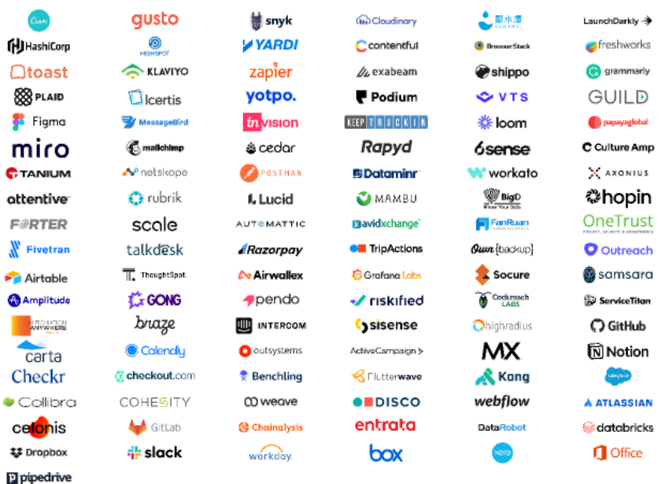
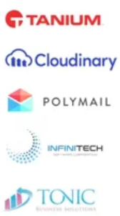
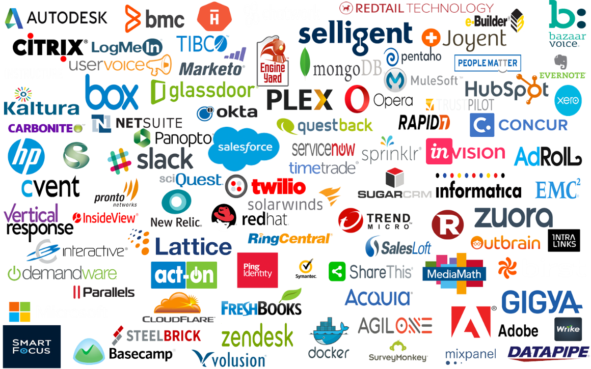
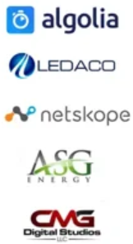
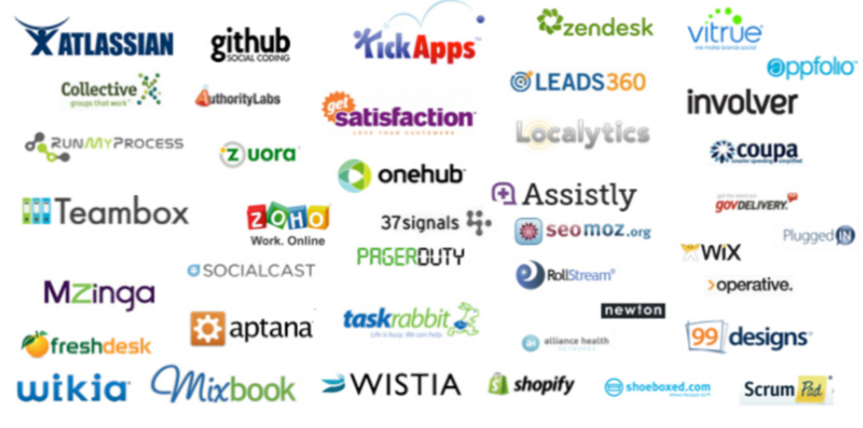
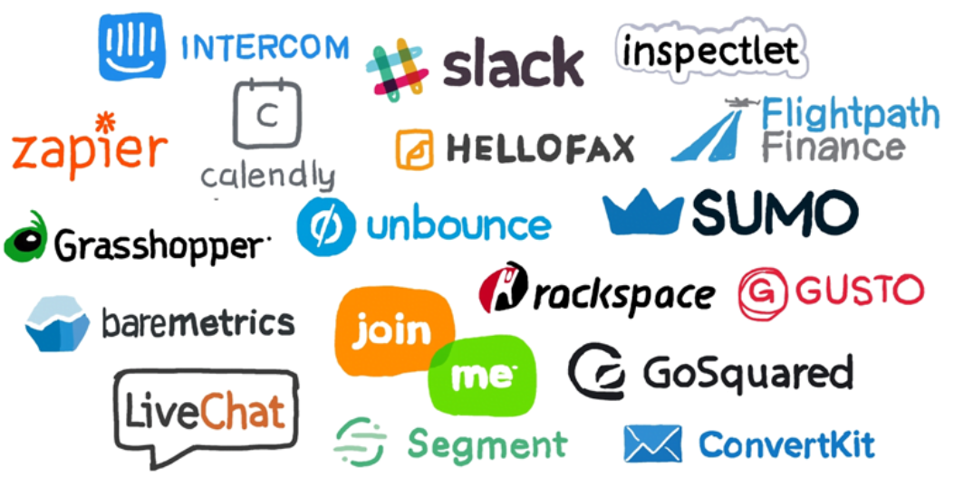

Slide 15
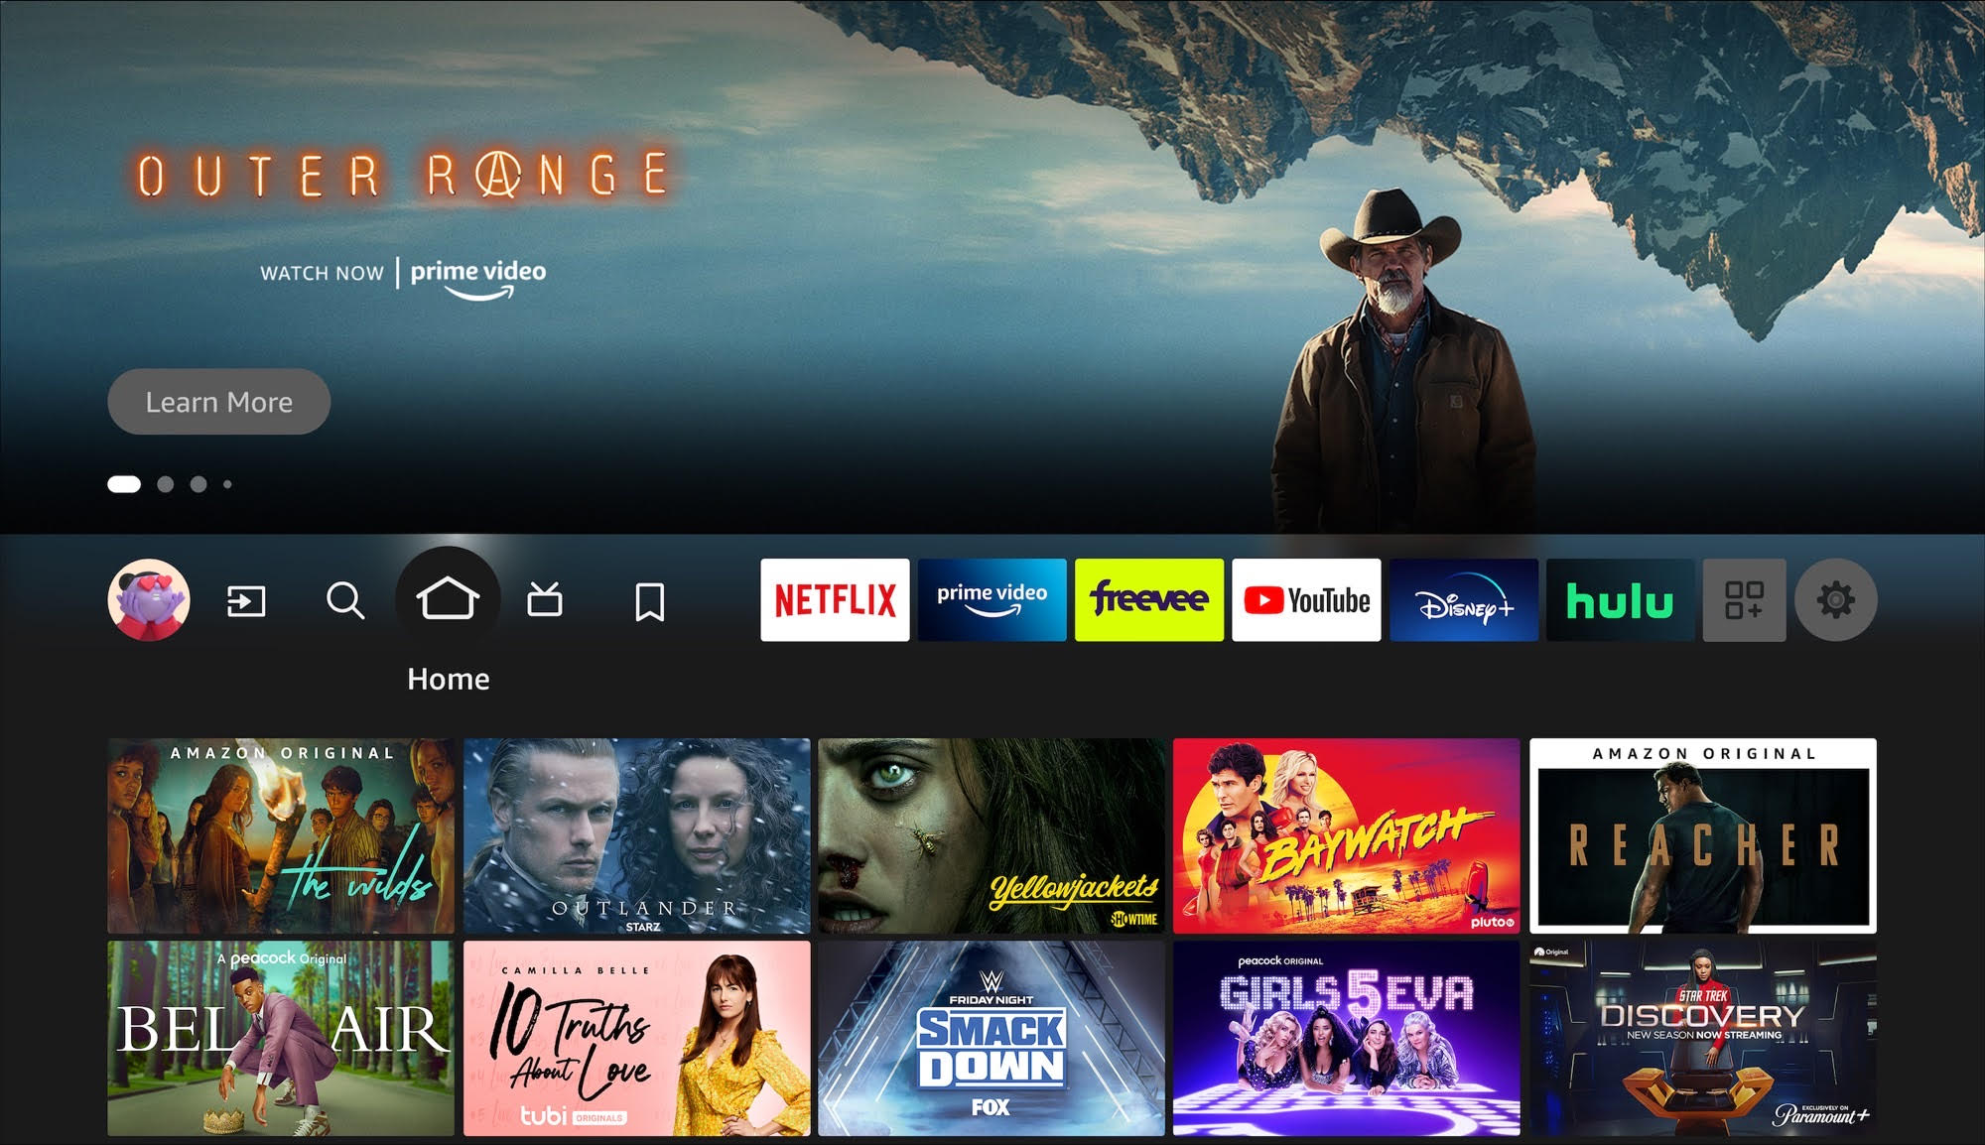

Slide 16
Where Do You Begin?

Slide 17
1. Document
Think Through Your Day:
What software are you using?
It is helpful to simply go through your day and note any program that you are using – do this for a week. Have your team do this as well
How often are you taking information and manipulating it in Excel?
Where do I feel frustration?
Example: Am I looking at something in a program, then combing through my e-mails?

Slide 18
2. Dream
What would “nirvana” look like?
How would I ideally be spending my day?
Examples
Someone calls in with a question?
How would I prepare my grant reporting?
What does it look like to prepare for a board meeting?
What is taking me away from achieving my mission?

Slide 19
3. Define
If I had a person fixing my problem, how would I define it?
Pro-tip – use Artificial Intelligence for a prompt:
Example Prompt: Write a job description for an accounts payable clerk:
We are seeking a detail-oriented and proactive Accounts Payable Clerk to join our Finance team. The successful candidate will be responsible for processing invoices, ensuring timely payments, reconciling vendor statements, and maintaining accurate financial records. This role is crucial in supporting the financial operations and maintaining strong relationships with our vendors.
Take the details and start asking yourself Questions
Sort, code, and match invoices – is there a way that we could eliminate data entry?
Monitor accounts to ensure payments are up-to-date – is there a way that we can be alerted for payments due, versus looking through everything?
How does this improve my ability to focus on my mission?
Do this for EVERY area of your operation

Slide 20
Technology Whack – a – Mole

Slide 21
4. DIscover
How do I begin looking in the marketplace for a solution?
Begin by knowing some basic jargon
ERP – Enterprise Resource Planning
This encompasses accounting and operations
Some have AI embedded within them
CRM – Customer Relationship Management
Manages your donor and constituents (some ERP platforms have this built in)
Point Solutions
These solve very specific problems – this could lead to technology whack a mole
AI – Artificial Intelligence
This requires some digital maturity to see full advantage
Check your LinkedIn Network
Is there someone you trust who works in technology?
Do you have any connections with people who work in professional services?
Accountant
Attorney
Colleagues
Google/Reddit
This is where to tread a little bit lightly
Google – often driven by search engine optimization
Reddit – people share the extreme stories

Slide 22
5. Deploy

Slide 23
Day 1

Slide 24
Year 1

Slide 25
Year 2

Slide 26
Year 3

Slide 27
5. Deploy
How to Avoid Digital Disillusionment
Have Appropriate Expectations
Implementations come with challenges
Do an Annual Review of Your Software
Define step discussed prior is critical
How do you evaluate employees?
360 Review
Goals
Performance Improvement Plan

Slide 29
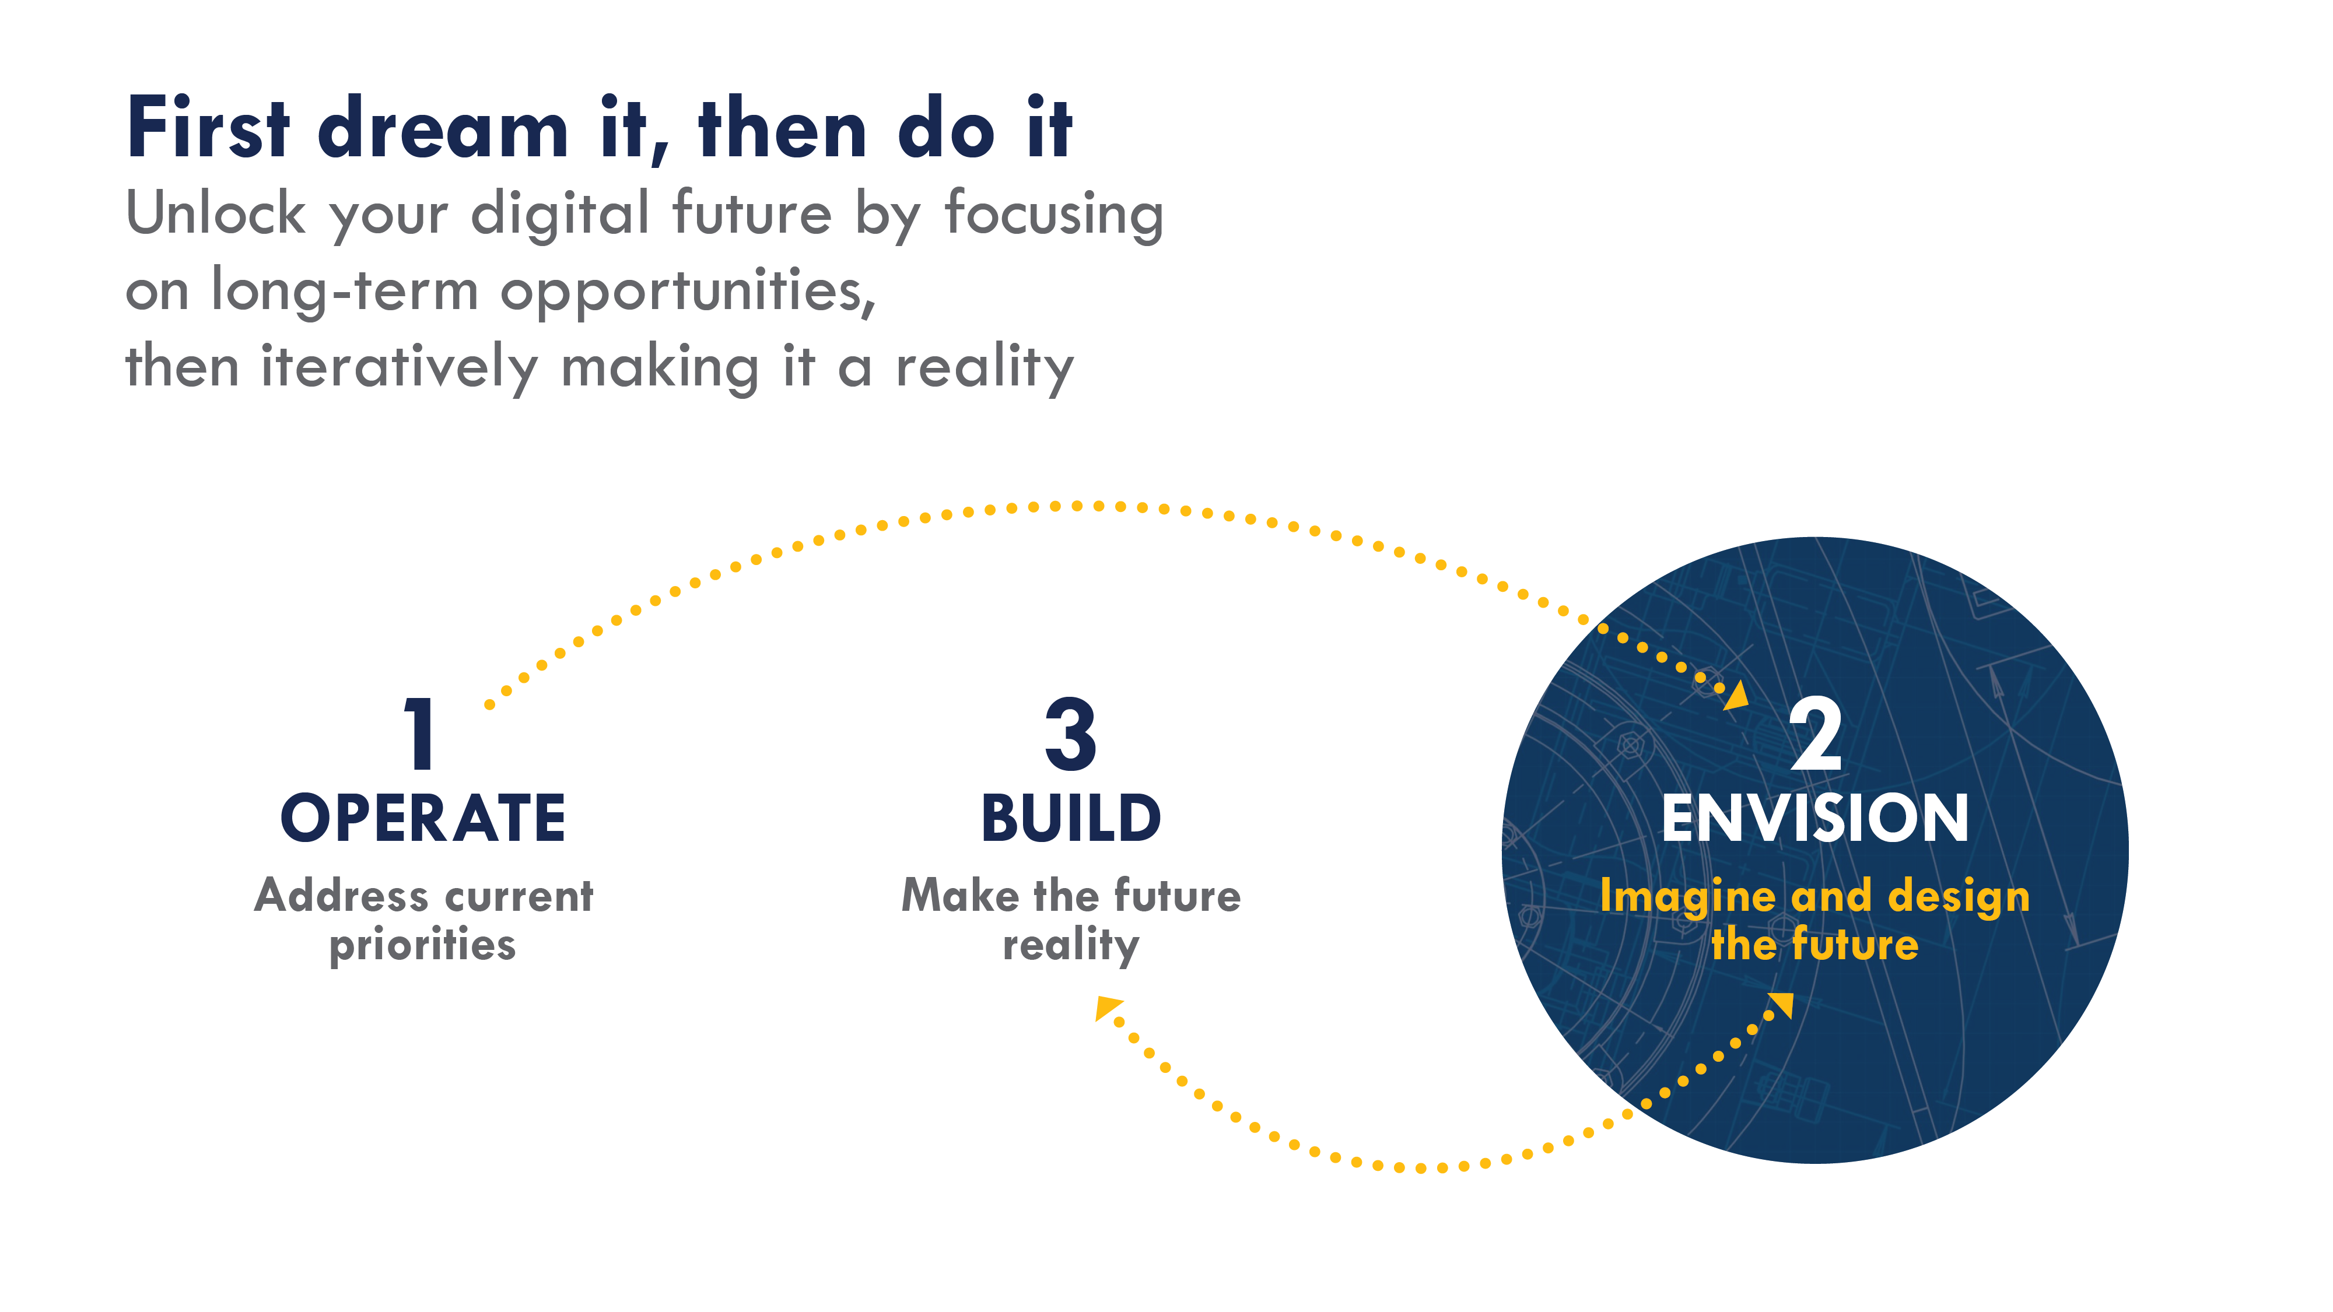

Slide 30
QUESTIONS?

Slide 31
Common Question #1 How do I find a technology?

Slide 32
Common Question #2 How do I Convince my board for investment?

Slide 34
Thank You!
Trina Michels
Senior Manager
tmichels@eidebailly.com
701.866.3192

