Slide 1
Welcome
Annual Member Meeting
May 30, 2024
Educate. Advocate. Connect.

Slide 2
Agenda
Call to Order
Recognition of Board Service
Returning Board Members
Year in Review
Looking Forward
Adjourn
Educate. Advocate. Connect.

Slide 3
Mission
Educate, advocate and connect to strengthen nonprofits.
Educate. Advocate. Connect.

Slide 4
2023 Board of Directors
Tim Chapman, International Peace Garden, Dunseith
Myrna Hanson, Vice President, Community of Care, Casselton
Kara Geiger, CFRE, Secretary, North Dakota Community Foundation, Bismarck
Anne Stoll, Treasurer, Eide Bailly, Fargo
Becca Baumbach, Community Foundation of Grand Forks, East Grand Forks & Region
Casondra Duckworth, Jeremiah Program, Fargo
Michelle Erickson, Abused Adult Resource Center, Bismarck
Melanie Gaebe, Alzheimer’s Association, Statewide
Patrick Kirby, Do Good Better Consulting, Fargo
Tracy LeDuc, Community Violence Intervention Center, Grand Forks
Sue Omdalen, Essentia Health Foundation, Fargo
Gayla Sherman, Missouri Slope Foundation, Bismarck
Stacy Schaffer, 31:8 Project, Bismarck
Lyndsay Ulrickson, Bush Foundation, Statewide
Murray Sagsveen, JD, Attorney
Educate. Advocate. Connect.

Slide 5
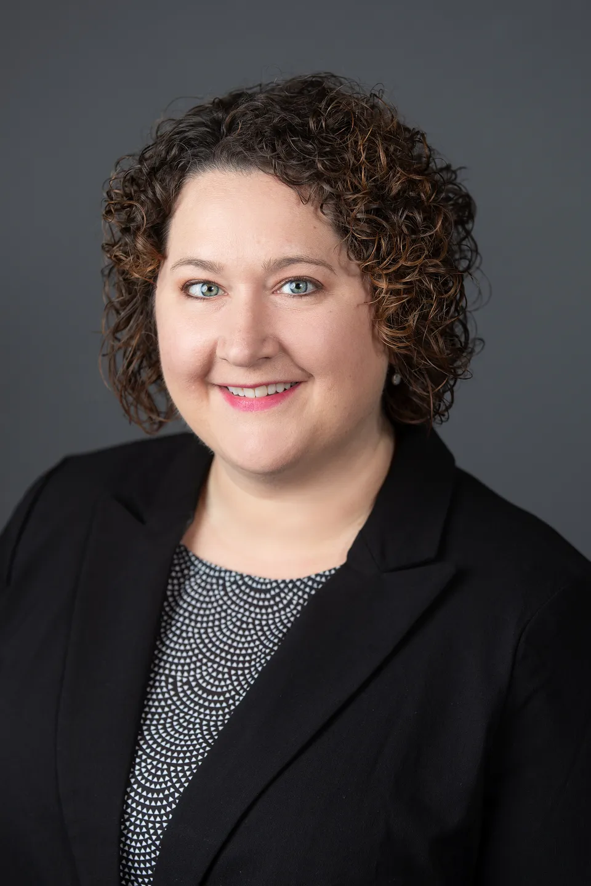
Recognition of Service
Educate. Advocate. Connect.
Kara Geiger, CFRE, ND Community Foundation

Slide 6
Returning Board Members
Tim Chapman, International Peace Garden, Dunseith
Myrna Hanson, Vice President, Community of Care, Casselton
Sue Omdalen, Secretary, Essentia Health Foundation, Fargo, CFRE
Anne Stoll, Treasurer, Eide Bailly, Fargo
Becca Baumbach, Community Foundation of Grand Forks, East Grand Forks & Region
Casondra Duckworth, Jeremiah Program, Fargo
Michelle Erickson, Abused Adult Resource Center, Bismarck
Melanie Gaebe, Alzheimer’s Association, Statewide
Patrick Kirby, Do Good Better Consulting, Fargo
Tracy LeDuc, Community Violence Intervention Center, Grand Forks
Gayla Sherman, Missouri Slope Foundation, Bismarck
Stacy Schaffer, 31:8 Project, Bismarck
Lyndsay Ulrickson, Bush Foundation, Statewide
Murray Sagsveen, JD, Attorney
Educate. Advocate. Connect.

Slide 7
Year in Review: NDANO in 2023
Educate. Advocate. Connect.

Slide 8
2023 Financials
Revenue: $159,268
Expenses: $ 136,728
Positive Cash Reserve: $263,760
Educate. Advocate. Connect.

Slide 9
2023 Nonprofit Membership (160)
By Budget
By Sector
Educate. Advocate. Connect.

Slide 10
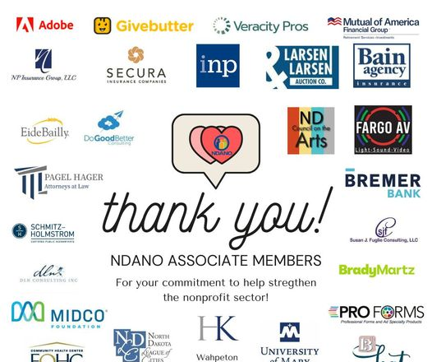
2023 Associate Membership (30)
Educate. Advocate. Connect.

Slide 11
Why Belong To NDANO?
Be Connected
Save Money.
Save Time.
Raise Money.
Effectively Manage.
Successfully Advocate.
Demonstrate Leadership.
Foster Collaboration.
Strive for Excellence.
Make an Impact.
Better Together.

Slide 12
2023
2023 Nonprofit Legislative Champion - Rep. Mary Schneider
Partnership Building Award - Community Foundation of Grand Forks, East Grand Forks & Region
Emerging Leader Award - Ted Uecker
Walt Odegaard Leadership Award - Kurt Snyder

Slide 13
Educate
Provide a variety of learning opportunities, sector news and best practice resources:
Held the annual Nonprofit Leadership Conference in Fargo with 108 attendees.
Shared more than 100 learning opportunities offered by partners, including an Xcel Energy partnership for “I have an I.D.E.A. (Identifying Diversity Equity and Assumptions) training; quarterly Firespring learning opportunities; SCORE workshop on Organizational Management; MindEdge programs; and much more.
Launched the monthly “Learning Lookout” education programming update.
Provided technical assistance and referrals to members and potential members.
Published the monthly Nonprofit Network newsletter and distributed information via email and social media on timely nonprofit issues.
Educate. Advocate. Connect.

Slide 14
Publications on MailChimp
Monthly Newsletter
Special Events
Funding Opportunities
Learning Lookout
Educate. Advocate. Connect.

Slide 15
Advocate
A voice for member organizations and the North Dakota nonprofit sector:
Tracked and monitored bills during North Dakota’s 68th Legislative Assembly.
Hosted Nonprofit Day at the Capitol with over 45 nonprofit organizations in attendance.
Represented nonprofits in the Main Street Initiative.
Sold and distributed the Nonprofit Advocacy toolkit.
Presented Advocacy 101 training to multiple groups.
Distributed the bi-monthly Nonprofit Advocacy Matters publication in partnership with the National Council of Nonprofits.
Marketed and distributed the North Dakota Nonprofit Sector Report.
Championed the sector on National Nonprofit Day on Aug. 17.
Educate. Advocate. Connect.

Slide 16
Connect
A network of members throughout North Dakota and across the country:
Engaged 160 North Dakota nonprofits as member organizations and 30 businesses, government agencies and individuals as associate members.
Partnered with nonprofit leaders to bring Dan Pallata’s “Uncharitable” movie screening to the historic Fargo Theatre.
Posted member job openings on the website and shared via the newsletter as a free member benefit.
Offered cost-saving/preferred partner programs for members.
Connected North Dakota nonprofits to national issues through membership in the National Council of Nonprofits, the largest network of charitable nonprofits in the nation that serves to spot trends and share information critical to every nonprofits’ mission advancement.
Educate. Advocate. Connect.

Slide 17
State Association Network
Educate. Advocate. Connect.
Notes:
Annual dues $2,500 (minimum) – based on members (max of $10K)
NCN staff of 8
Critical to NDANO’s success
--Monthly policy calls (recommendations to board on agenda and strategy)
--Listservs for policy, resource development, training, membership, communication
--Regular calls on above (i.e., annual conference round-up, e-learning, fundraising, etc.)
Dana are you on any of the NCN committees?

Slide 18
Looking forward
2025-2027 Strategic Planning Session

Slide 19
NDANO Staff
Dana Hager
Shannon Schutt
Michaela Kauk
Educate. Advocate. Connect.

Slide 21
Adjourn
for belonging to NDANO!
Thank you

