Slide 1
Harnessing the Power of Media for Nonprofits Amanda Godfread, Make-A-Wish North Dakota Hope Sisk, Agency MABU

Slide 2
Agenda
How to make interviews easy
Get inside a reporter’s brain
6 Tips for successful media coverage
Ideas to find your next pitch
Final tips & takeaways

Slide 3
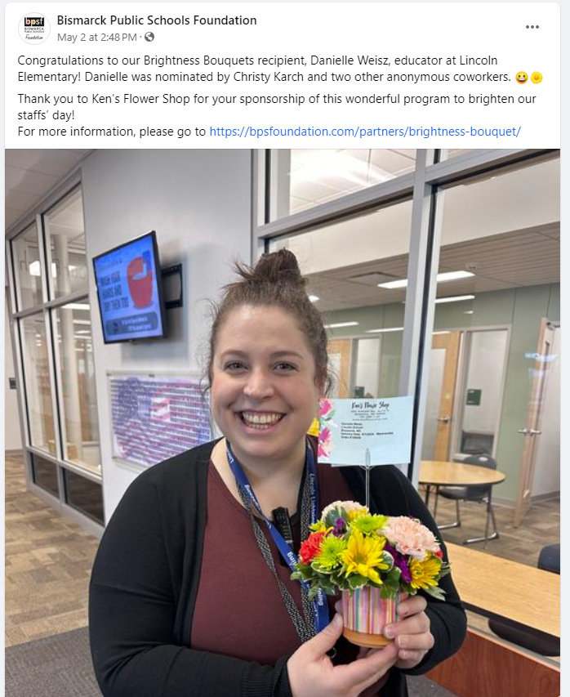
The power of the media
Brightness Bouquets through Bismarck Public Schools

Slide 4
Don’t fear the interview This is not about YOU
Notes:
Amanda: This is not about YOU
Most people don’t like how they look/sound on air or in print, so they get flustered or clam up. The reality is, no one listening/reading cares about YOU or will remember YOU. They are interested in your topic.
This is a chance to give your organization/event a bigger spotlight.
This is about educating and inspiring.

Slide 5
Making interviews feel easy
What reporters want: meet deadline, gather visuals.
Hack: direct your own visuals.
What a press release can’t give them: emotion, descriptive responses, a “real person.”
Ask yourself: does my audience care about what I care about?
How can you refresh a boring message?
How can you build a bridge to the audience’s interests?

Slide 6
6 Tips for successful media coverage

Slide 7
6 Tips for successful media coverage
Find the right spokesperson
Get active
Start with b-roll
Remember you have the power
Get to know the interview process*
Re-purpose your interview

Slide 8
Finding your next pitch
Promote the people behind the event.
Demonstrate the power of donation drives.
Show how the community is impacted by issues that impact you.
Your daily operations are newsworthy.
Your stories are also worth the time investment.

Slide 9
Final tips & takeaways
Take the pressure off. Consider the following tips for feeling empowered to take your story to the media:
Reporters/hosts are people, just like us
Perfect is the enemy of good
Your stories are important
Have a plan for the interview, visuals, & message
Get familiar with the process
Consider media coverage a launch pad to greater awareness

Slide 10
Thank you

