Slide 1
Mindful Mental Health
Taking Care of You and Communicating with Others
Nonprofit Leadership Conference
May 2024
Notes:
Andrea welcome

Slide 2
Objectives
Define stress
Learn tips to juggle life’s pressures
Develop a wellness plan
Focus your time
Prevent board burn out
Notes:
Andrea

Slide 3
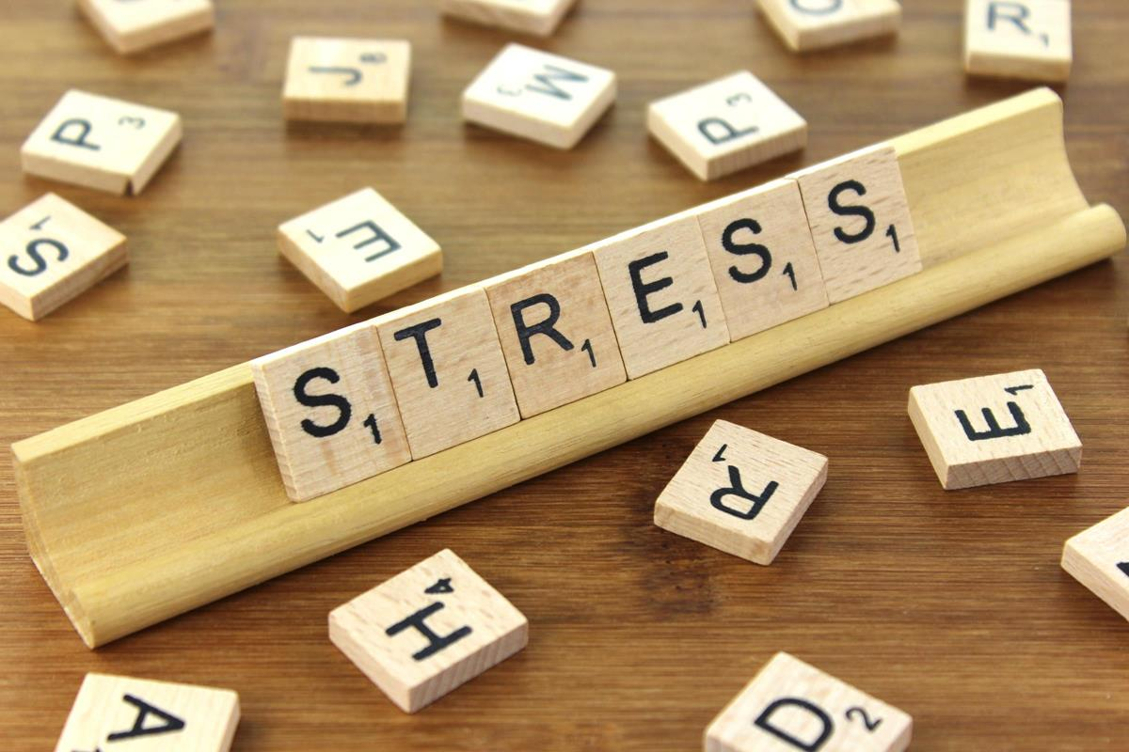
What is stress?
World Health Organization
Stress can be defined as a state of worry or mental tension caused by a difficult situation.
Stress is a natural human response that prompts us to address challenges and threats in our lives.
Everyone experiences stress to some degree.
The way we respond to stress, however, makes a big difference to our overall well-being.
Notes:
Adriana
Define Stress
What are stress symptoms?
Emotional: frustration/moody, feeling overwhelmed, low self-esteem
Physical: grinding teeth, insomnia and low energy, sweaty hands and feet
Mental: nail biting, lack of concentration, changes in sleeping habits, drug or alcohol use
Social: avoiding others
What are consequences of stress?
Health: mental health, cardiovascular disease, skin and hair problems, gastrointestinal problems
Unbalanced work and family life
In short bursts stress can help increase productivity or maintain focus
Chronic stress can contribute to health problems like high blood pressure and heart disease
Stress is very common, most of us cannot escape it
More than three-quarters of adults report symptoms of stress, including headaches, tiredness or sleeping problems (American Psychological Association, 2019)
80% of US workers say they experience stress on the job (American Institute of Stress)

Slide 4
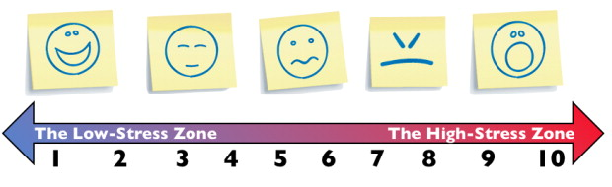
Your Personal Stress Zone
How Stressed Do You Feel?
Notes:
Adriana
Key Points
Each person who is affected by stress may respond physically, mentally or emotionally in different ways to such pressures. Conducting regular “self-checks” is important to be aware of your own experience with stress and what steps you can take to stay out of the “high stress” zone.
Personal application – Have participants privately assess where they might be in the “Stress Zone” on a scale of 1 to 10.
We can add another activity if we have time – a table to measure levels of stress

Slide 5
Personal, Family & Professional Pressures
Outside
obligations
Public meetings
Making ends
meet
Winter weather
Holiday planning
Deadlines
Family and
relationships
Work demands
Notes:
Andrea
Key Points
Discussion activity – What are some of the unique pressures that occur in your lives that result in feeling stressed? Allow participants to respond and share some ideas before you progress the slide show to the remaining items on the slide (examples).
Some of the pressures that occur in your life are unique and beyond your control, which can be difficult and lead to feelings of frustration. Because of this pattern, focusing on what you can do to control how you respond to stressful conditions is important.
Stresses can come from many directions, including:
Responding quickly to a crisis or news story – deadlines
Work demands and obligations
Difficulty with spouse, children or parents
Long hours, fatigue, getting worn out
Meeting with the public, officials
Conflict with family, partners, employees or others
Physical or mental health concerns
Making ends meet

Slide 6
Juggling Life’s Pressures
Recognize & Manage Stress
Work to Develop Skills to Focus
Discuss Balancing Work & Family
Notes:
Andrea
The juggling act of work, personal and family life can be challenging. Does true balance exist?
To find peace in the balancing process, time management is a very important skill.
We are often juggling lots of things -- work, family, volunteering, community events.
Today we will offer you some tools for your wellness toolbox and will focus on how to manage the juggling act and find work/life balance, how to be an effective team member at home and at work, and how to clearly and effectively communicate to avoid stressful situations.

Slide 7

What is a Healthy
Work-Life Balance?
Define Balance – A condition in which different elements are equal or weighed in the correct proportions.
How do you balance it all?
  Family time
  Holiday shopping
  Work deadlines
  Kids activities
  Chores (cleaning) and Enjoyable tasks (baking)
  Community (church, friends)
Notes:
Adriana
What is balance?
Do we need to have equal parts to feel balance? How do we balance different aspects of our lives?
Does it stress us not to find balance? Maybe we experience burnout?

Slide 8
Work-Life Challenges and Personal Stress
Question: Key personal resources or assets?
Your health is your most important asset for daily functioning and productivity.
Personal health and wellness is the most important priority in managing life tasks and challenges.
Good stress management is good life management!
Notes:
Adriana
Key Points
Activity – Question to Explore: First, advance only to the question activity and ask participants to identify key personal resources or assets they depend on for daily functioning and productivity. Next, introduce the idea that health is the most important asset for an individual to function and be resilient. Then proceed to the next points on the slide.
Among all the assets in a person’s life, such as money, shelter, food, or other items, the health of the individual involved and quality of their relationships are the most important assets to consider, though they may not typically be listed as assets.
If health and quality of relationships are the most important assets in a person’s life, then health and wellness of individuals needs to be the most important priority in managing one’s life and challenges. You need to develop a good plan to manage and improve health.
Good stress management and pursuing health is good life management!

Slide 9


Taking Care of Your Health
Are you running on a full battery?
Prioritize your needs
Write down your plan
Be proactive
Is your “check engine” light on?
Notes:
Andrea
If your health is an important priority and a main asset in your life, then you need to take care of yourself so you can take care of others, both at home and at work.
Ask yourself these questions:
Is your “check engine” stress light on?
Are you running at a full battery or is your energy drained?
Monitor your own dashboard – prioritize your daily needs. Just like the light on the dashboard of the car tells us that we are running low on oil or the battery power is low, we need to make sure we pay attention to our needs. You must add you to the list of people that you need to monitor. Take time and write down your maintenance plan for your own health: what is important today, tomorrow, next week. Plan, be proactive.

Slide 10

What Do We Do When Feeling Stressed?
What are some negative coping strategies we use?
Binge eating
Blowups at others
Spending Sprees
Alcohol Over-use
Self medication
Avoiding others, activities
Notes:
Andrea
What do we do when we are feeling stressed?
Negative ways to cope with stress: Binge eating, blowups, spending sprees, alcohol use, drug use, too much caffeine.
We should avoid these negative coping mechanisms and focus on healthy ways to cope with stress.

Slide 11
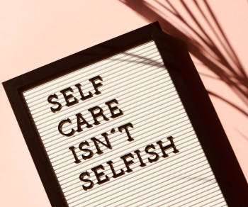
Self-care
Take time to do things that help you live well and improve your physical and mental health.
It is a framework for managing stress, life challenges, professional burnout and compassion fatigue.
Be pro-active.
Notes:
Adriana
According to the National Institute of Mental Health, self-care means taking the time to do things that help people live well and improve their physical and mental health.
Ask the audience: What does self-care mean to you?
Self-care means taking time to do the things that nourish and support you; self-care practices help you feel rejuvenated, refreshed and recharged. You can more easily stay on top of things without feeling so drained and burnout.
We live in a world that values hard work and that is why we feel guilty for taking time for ourselves. On the contrary, taking time for yourself can make you more productive as it gives you a boost of energy and can reduce mental fogginess.

Slide 12
Six Dimensions of Wellness
Personal & Spiritual
Physical
Mental
Emotional
Relational
Professional
Financial
Notes:
Adriana
Key Points
There are a number of different wellness models that highlight the different but inter-related dimensions of wellness in our lives.
In the model we have developed for use in the wellness planning process, we emphasize that personal and spiritual wellness lies at the center of our lives and wellness. It is difficult to be healthy in other areas of life if we do not prioritize our personal wellness.
Additional dimensions of wellness that are emphasized in this wellness planning model include:
Physical Wellness
Mental Wellness
Emotional Wellness (includes elements of spiritual)
Relational Wellness (includes both care for self and care for others)
Professional Wellness (includes work, environment, etc.)
Financial Wellness (also includes practical issues)
Application Activity: We will briefly explore two wellness strategies linked with each dimension of wellness. You can use the wellness planning documents to consider which dimensions need to be emphasized in your life and the wellness strategies that you want to pursue in your wellness plan. We might call these “wellness hacks” – they can change your wellness and change your life!

Slide 13
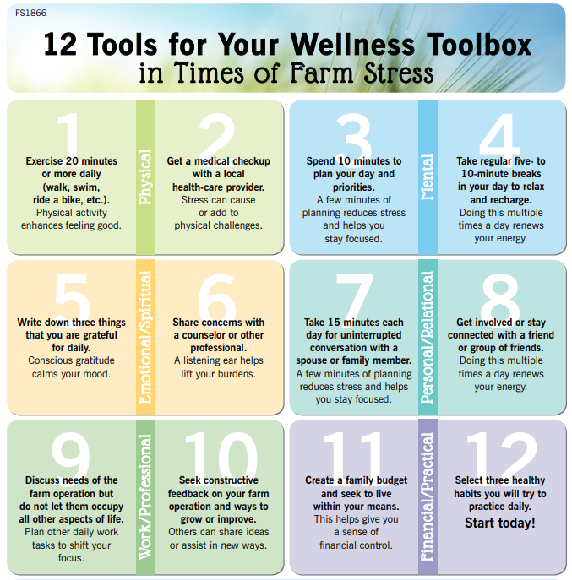
Notes:
Adriana
Most of the wellness activities and tools just take time and commitment (do not require you to spend a lot of money).
Some examples are: exercise, medical check up, spend 10 minutes to plan your day, take a 10-15 minute break and walk away from your desk/computer, use a gratitude journal, talk to someone. Let’s explore these!

Slide 14
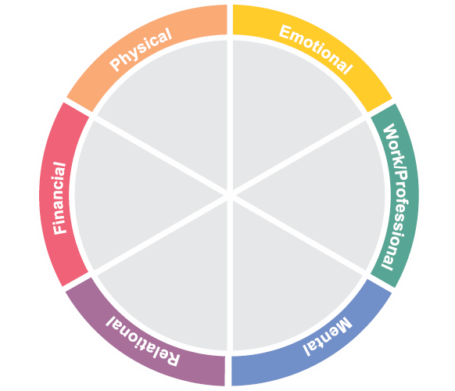
Wheel of Wellness – Self-Care
Notes:
Adriana
Use this Wheel of Wellness to identify the activities that are currently working for you or that you would like to try for the six dimensions of wellness. You can also assess how you are doing in each dimension, if we were to use a scale of 1 to 5 and I am really satisfied in my Physical dimension I can give it a score of 5 - that means I am doing I need to feel satisfied, maybe I am eating healthy and I finally got to walk 45 minutes five times a week. But what if I am having problems at home, constant discussions and at work I do not seem to be able to engage with my co-workers, my score could be a 1 or 2 – what does this mean? it means that I really need to work hard on the Relational dimension of self-care; I may need to find a way to understand that my partner is really stressed and I need to support him instead of fight with him all the time. My co-workers need me to be more accepting of their ideas and that would make for a better work environment. By doing this you have an opportunity to take time to reflect and find the activities that will help you in the six dimensions of self-care.

Slide 15
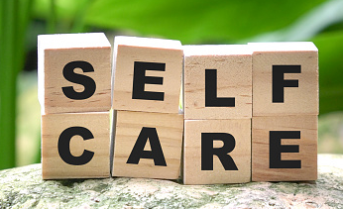
Self-Care = Wellness Planning
What is self-care?
  Activities to care for your needs
Coping priority #1 – Well-being
Daily or weekly habits:
  Monitor your stress levels
  Regular routines – daily, weekly
  Help you feel and perform your best
  What helps you to reset?
  Connect with other supports
Notes:
Andrea
Self-care means the activities you do to take care of yourself.
Self care is routine and typically involves daily or weekly habits that help you feel and perform your best.
Examples – Go for a drive, watching a movie with family, exercise, just taking a half hour to relax and do nothing.
Burnout-how do you know it is time for a reset?
What is the best reset for you?
Connect with supports in your life.
1) Create your self-care plan – 2) Fill your self-care plan with activities that you enjoy – 3) Keep this plan in a place where you can see it every day; you can share with your supervisor, colleagues, friends and family so they can support you in your actions – 4) Re-assess how you are doing at the end of the week, month; plans can take over a month to become habits so check-in and be realistic.
What are habits you have developed to help you?
Self-Care Check in Questions
• How have you been practicing self-care today?
• Have you smiled a little bit today?
• Have you eaten today? In the last 3 hours?
• Are you hydrated? • Have you stretched or moved your body?
• Have you taken a moment to breathe deeply?
• Did you sleep for at least 7 hours last night?
•Have you reached out to friends or family today?
•Have you done anything today that you enjoy?
•Did you do your hair/makeup or are you wearing clothes you like?
•Have you listened to some good music, a podcast or book recently?
•Have you been outside today? Or spent time with another person? (video/phone)
•Have you meditated today or spent some time in silence?

Slide 16


Physical Wellness – Body Basics
Key Factors to Promote Physical Wellness include Four Fundamentals:
  1) Exercise & Fitness – 20 min/day – get moving!
  2) Health Care – get a checkup
  3) Sleep Habits – 7+ hours
  4) Diet + Nutrition = Good Eats
Notes:
Andrea
Key Points – Physical Wellness
Physical Wellness relates to our bodies and our capacity for mobility, movement, physical tasks and overall physical health.
The most impactful wellness strategies to focus on and improve physical wellness include:
1) Exercise and Fitness – get up and get moving! It has been said that “sitting is the new smoking” – neither one is positive for your physical health! The important guideline here is to engage in at least 20 minutes of daily physical activity that gets you moving and exercising. Healthy physical activities can include walking or jogging, swimming, riding a bike, dancing, or other efforts. Physical activity also boosts positive emotions and enhances feeling good.
2) Get a medical check-up with a local health-care provider. To use a gardening comparison, this is like doing a “soil health assessment” on a patch of ground to assess its condition for growing crops. What is your physical condition and are there any key items you need to address? A health-care provider can provide a basic physical health assessment as well as a mental health assessment. Stress can either cause or add to physical health challenges, so an assessment will provide you with a good beginning point to move forward in addressing physical health needs.
3) Sleep habits sustain physical health – for adults, 7 hours a night or more.
4) Consider your diet and nutrition choices. Any productive effort to improve wellness is likely to involve thinking about your choices of what you eat on a regular basis and its effect on your health.

Slide 17

Mental Wellness – Mind Matters
Key Habits to Promote Mental Wellness include:
  1) Plan and Prioritize – 10 mins/day
    What’s on your 3x5 card?
    How you start your day – review schedule and priorities, be realistic
  2) Build in “rest and recharge breaks” daily, weekly (“Thrive with 5”).
    5-10 minutes each hour; 15 minutes each 2 hours
Notes:
Adriana
Key Points – Mental Wellness
Mental Wellness relates to our thoughts and our minds, our ability to think clearly, make decisions, continue learning and exercise good judgment.
Two useful wellness strategies to focus on and improve mental wellness include:
1) Daily Planning and Prioritizing – Early in each day, it is most helpful to set aside 10 minutes to plan your day and set priorities. Use whatever approach works for you, but even just writing down key priorities and tasks on a 3 x 5 card each day can help you stay focused and help in making decisions. Stress can make you feel rushed, impulsive, panicked or overwhelmed. A few minutes of daily planning and prioritizing helps to reduce stress and maintain a healthy mental focus.
2) Rest and Recharge Your Brain Using Short Breaks – For mental wellness, take regular 5 to 10-minute breaks throughout the day to relax and recharge your brain. Your brain is like your cell phone – it needs a few minutes to get recharged quite often for optimal functioning. Research suggests that you should “take a break” for at least 5 to 10 minutes each hour, or 15 minutes every two hours. You might walk, stretch, listen to music, visit with someone, or even take a 10-minute “power nap.” Doing this multiple times a day renews your mental energy and recharges your mind for focus and decision making. One initiative has called this the “Thrive with Five” approach. Try it!

Slide 18

Emotional Wellness –
Feelings Focus
Key Factors to Promote Emotional Wellness include:
  1) Conscious Gratitude = Appreciation for Life – “Gratitude Journal” or write down 3 things daily you are thankful for
  2) Talk and share with others who understand or who you can trust (counselors, pastor, etc.)
    Ask – “Who have I connected with today?”
Notes:
Adriana
Key Points – Emotional Wellness
Emotional Wellness relates to our feelings and general mood, including feeling anxious or at peace, discouraged or optimistic, inadequate or resilient. Emotional wellness is also linked with our spiritual wellness and feeling able to navigate stresses and transitions in life.
Two useful wellness strategies to focus on and improve emotional wellness include:
1) Conscious Gratitude Exercise – Did you know that research has shown doing a simple conscious gratitude exercise is typically the most effective thing you can do to lift your mood daily? Simple! Set aside 5 minutes to write down and reflect on three things you are grateful for that day – this is Conscious Gratitude. If it involves others, you may want to thank them with a note or text or phone call. You may use a “gratitude journal” or simply write down three things each day, but doing a conscious gratitude exercise calms your mood and cultivates appreciation for life.
2) Communicate Concerns with a Counselor or Other Connection – This strategy for emotional wellness simply means thinking about a concern or stressor in your life and connecting with someone else to share it. Sharing your emotions helps to process your emotions and not remain paralyzed by them. A listening ear helps to lift your emotional burdens. So, think of someone you can talk or share with who understands you or who you can trust – a counselor, a pastor, a spouse, a parent, a sibling, a friend, an adviser. Ask yourself: “Who have I connected with today?” For some, this might mean a prayer while for others it might mean a conversation.

Slide 19

Relational (Social) Wellness – Connection Keys
Key Factors to Promote Social Wellness include:
  1) Take daily “talk time” with a spouse, family member or friend (15 mins day) – “connecting conversations”
  2) Connect with others who give you strength, support – friend, friend group (fishing buddy, sports friend, etc.); OR activities that renew you
This Photo by Unknown Author is licensed under CC BY-SA-NC
Notes:
Adriana
Key Points – Relational Wellness
Relational Wellness (also known as Social Wellness) relates to our relationships and interactions with others, our communication with others, our positive or negative interactions, and the overall quality of caring for and connecting with others.
Relational or social wellness helps us to avoid “diseases of despair,” identified as more common among rural populations, such as depression, suicidality, drug abuse or alcoholism. Loneliness has been identified as a major health concern, so connecting with others can improve our general wellness.
Two useful wellness strategies to focus on and improve relational wellness include:
1) Connecting Conversations – Much of our wellness depends on staying connected in the relationships that matter most. For social or relational wellness, make it a priority to conduct at least one “connecting conversation” each day with someone in your life. This means focusing on at least 15 minutes of “talk time” that involves uninterrupted conversation with a spouse, family member, friend or other caring connection in your life. Such “connecting conversations” tend to significantly reduce stress and renew relationships. Instead of focusing on problems, focus on laughter, positive moments, hopeful expectations, or other uplifting topics to connect around.
2) Connecting Activities and Supports – Relational wellness includes taking care of yourself, and this strategy encourages taking time to prioritize and engage in activities or relationships that you enjoy or renew you. Who do you like being with or what activity do you enjoy that promotes your health? This strategy means getting involved with an activity that renews you – reading, sports, music, games, crafts or other ventures. Or, it means getting involved or staying connected with a friend or group of friends, people who give you strength, support or friendship –a fishing buddy, a sports friend, etc. Engaging in these connecting activities or relationships on a regular basis, each day or multiple times a week, promotes both relational and overall health.

Slide 20

Professional Wellness –
From Work to Wellness
Key Factors to Promote Occupational Wellness include:
  1) Discuss job/work needs but don’t let it occupy ALL your life
    Take one thing OFF your “work to do list” each week – replace it with a wellness activity
    “Shrink” the work mindset
  2) Seek constructive feedback on your work efforts and ways to manage, grow or improve
    Professional development courses
    “Growth mindset”
This Photo by Unknown Author is licensed under CC BY-SA
Notes:
Key Points – Professional Wellness
Professional Wellness, also identified as work or occupational wellness, encompasses our satisfaction with our work experiences, our comfort and productivity in a work or professional setting, and our work-related environment and relationships.
Most of us are engaged in professional activities on a daily basis, whether pursuing work-related tasks or relating to others in a work or professional setting. Much of our time and energy happens in a work-related setting. In your context, what are some strategies to engage in improving work or professional wellness?
Two useful wellness strategies to focus on and improve professional or occupational wellness include:
1) Put Boundaries on the Work Activities and Focus – Working in an occupation can become all-encompassing and take all your time and energy, especially in times of stress or difficulty. But, that is only one dimension of a person’s life. Val Farmer, a rural psychologist, encourages us to “shrink the farm,” which means to put some boundaries on our focus and engagement with work activities or needs. You can discuss work activities, yes, but don’t let it occupy all of your life or energy or conversation. Set some boundaries. Plan other daily work tasks to shift your focus. For example, take one thing off of your “work to do list” each week – and replace it with a wellness activity! This helps you so that activity at work doesn’t lead to “burnout” and/or “spillover stress” into all other areas of your life.
2) Be Willing to Learn and Change – There is always change in the workplace, which means you need to consciously adopt a “growth mindset” or learning mindset in your professional activities. Seek constructive feedback on your work efforts and be open to suggestions or changes. Seek ways to grow and improve. A learning mindset helps you to be proactive in dealing with challenges rather than reactive to stressful conditions. Others can often share ideas or assist you in new ways. Whether you take a professional development course or have an assessment done of your work, take advantage of learning opportunities or tools to enhance your occupational wellness and satisfaction.

Slide 21
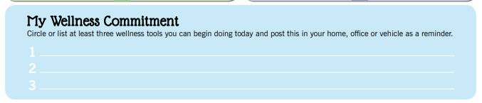
Commitment to Focus on Wellness
Key Factors for Your Wellness Plan:
Identify at least three “healthy habits” that you can begin today
Take time to create a wellness plan for yourself, considering each area
Find 1-2 individuals who will be your “wellness partners”
Notes:
Andrea
Commit to working on wellness – start TODAY
Who will support you and how can you support others?

Slide 22

Big Picture - What Are You Focusing On?
What you focus on can make all the difference!
  Refocus if needed
Vision
  What do you want your life to be?
Goals & Top Priorities– is your wellness included?
Notes:
Andrea
Communication and clarity is important – Focus On your wellness and stress reduction.
Be comfortable/at peace with decisions to prioritize health, refocus if needed.
Ask for help/take the offer.
Don’t be so wrapped up in meeting goals that you forget to enjoy the journey.
List your top priorities and then list how you spend your time and money.

Slide 23

Big Picture – How to Help Others Toward Wellness
Wellness needs to be everybody’s business = priority.
  Listen as needed to others
  Recognize problems of stress and burnout
  Notice signs of difficulty
  Provide education
  Gather resources
Notes:
Adriana
Check-in on friends/co-workers.
Make sure you slow down to notice how others around you are feeling.

Slide 24
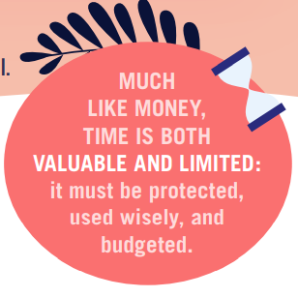
Big Picture –
Time Management Tips
Know how you spend your time
Set priorities
Use a planning tool
Get organized
Schedule appropriately
Delegate: Get Help from Others
Stop procrastinating
Manage time wasters
Avoid multi-tasking
Stay healthy
Notes:
Adriana
YOU are the only one that can manage the events in your life in relation to time.
You only get 24 hours-1,440 minutes and 86,400 seconds each day.
Self-analysis, planning, evaluation and self control
Are your time management strategies working? Are you accomplishing the tasks that are most important in your life?
Are you investing in your own personal wellbeing?
Maybe you need to reevaluate your time management strategies. Successful time management leads to greater personal happiness and more accomplishments

Slide 25

Board Burnout
Review board meeting functions
  Are meetings efficient & effective?
  Are there jobs that can be hired out?
  Do board position descriptions match duties?
  Are meeting schedules and information consistent?
Notes:
Andrea

Slide 26

Communicating to Prevent Board Burnout During the Meeting
Schedule breaks
Celebrate success-focus on the positive.
Provide opportunities for self-care.
Provide opportunities for education and self development.
Notes:
Andrea

Slide 27

Everyday tips
Mindfulness – Pay attention to the present moment
Breathing Exercises – Box breathing
Create Positive States of Mind – Build your resilience plan and engage in activities that create positive emotions
Notes:
Adrianna
Mindfulness means an awareness of one’s present moment. Mindfulness meditation may lead to a number of positive outcomes including reduction in stress and overall enhanced wellbeing. If you find mindfulness challenging it may be best to take a break and try again later. Yoga is a mindful activity that al of us can incorporate to help with stress reduction.
Research shows that breathing techniques reduce the production of hormones associated with stress such as cortisol. Breathing exercises do not have to take a lot of time. Begin with just 5 minutes a day and increase as you feel more comfortable. If 5 minutes feels too long, start with 2 minutes. Good to practice conscious breathing as you feel the need. Make yourself as comfortable as you can, you can lay down on the floor, sit or stand. Box breathing: Today let’s just sit comfortable on the chair with our feet on the floor, our arms on our lap and our eyes closed. Step 1: Breathe in, counting to four slowly, feel the air enter your lungs. Step 2: Hold your breath for 4 seconds. Step 3: Exhale slowly through your mouth for 4 seconds. Step 4: Hold for 4 seconds. Repeat.

Slide 28

“Sometimes the most productive thing you can do is relax.”
Mark Black
Notes:
Andrea
It’s the small habits.
How you spend your mornings.
How you talk to yourself.
What you read.
What you watch.
Who you share your energy with.
Who has access to you.
Knowing these habits and prioritizing wellness will change your life.
Reminder to identify
3 Wellness steps and 2 action steps
Time is a precious commodity, use it wisely. Create great habits and make today great!

Slide 29
Any Questions?
Comments?

Slide 30
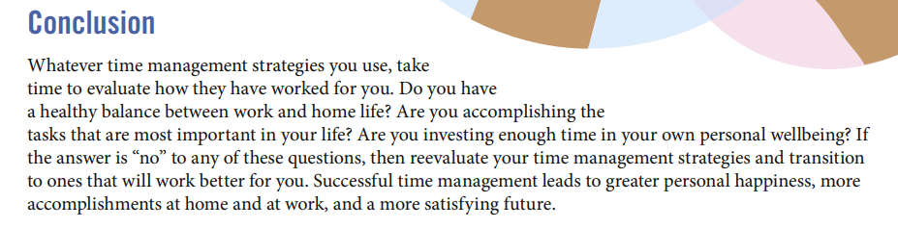
Time Management Assessment
Notes:
You only get 24 hours-1,440 minutes and 86,400 seconds each day.
Self-analysis, planning, evaluation and self control

